Slide 1




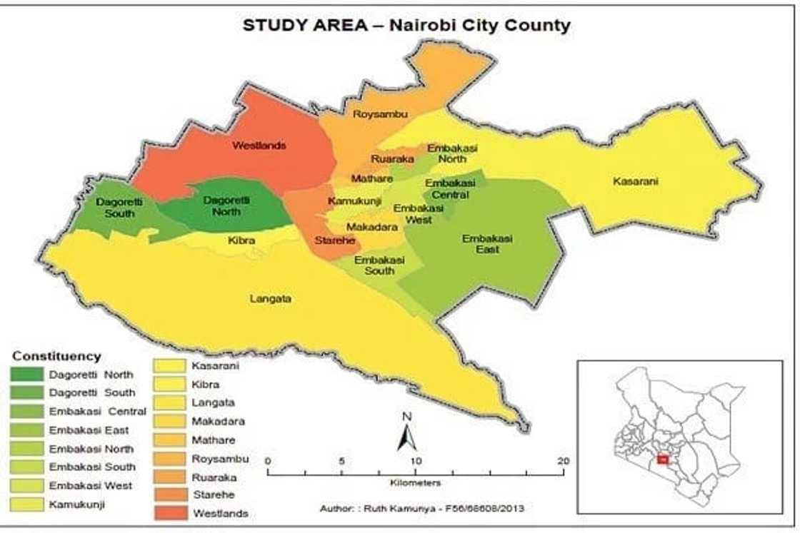
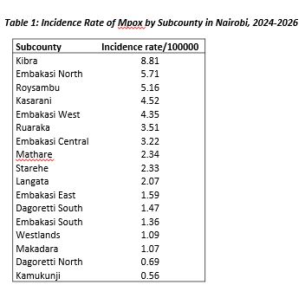
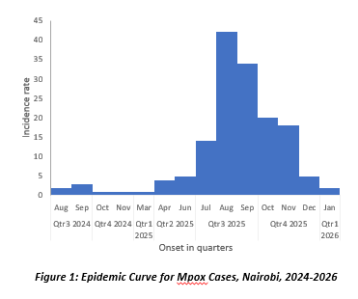
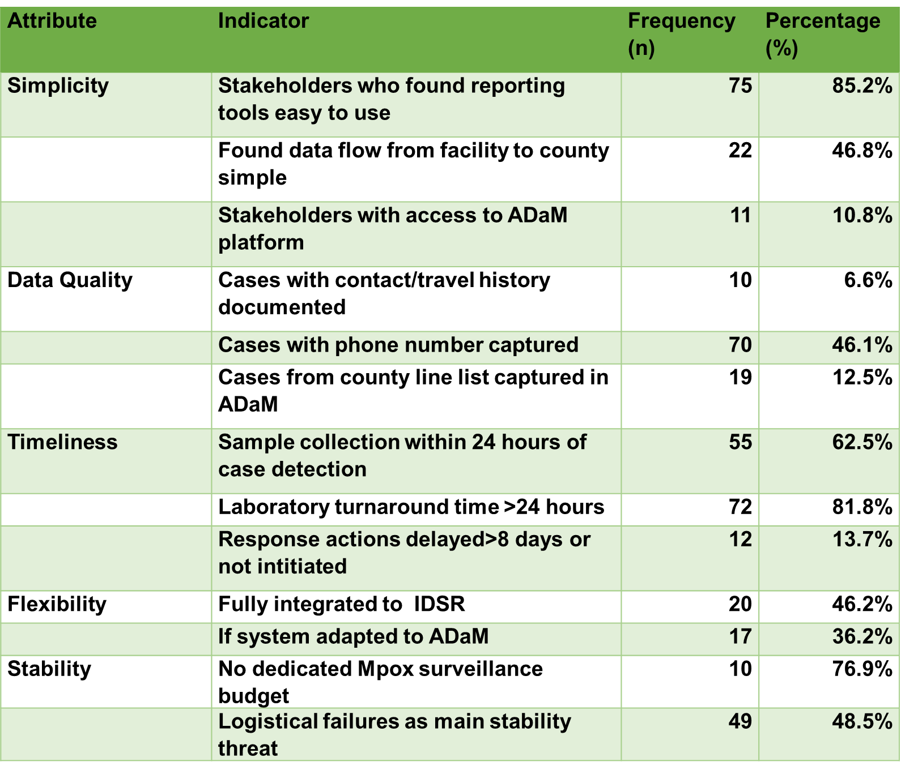

An Evaluation of the Mpox Surveillance System in Nairobi City County, Kenya (2024–2026)
Emmaculate W Kyalo¹^{,3}, M. Owiny²^{,3}, B. Waweru³, S. Mahero¹ , J. Githuku²^{,3}
¹ Department of Preventive and Promotive Services, Nairobi City County,² Africa Field Epidemiology Network
³Kenya Field Epidemiology and Laboratory Training Program
BACKGROUND
Mpox is a viral zoonotic disease transmitted via animal contact and human-to-human routes.
In Kenya, Mpox emerged in 2024; by January 2026, Nairobi City County reported 152 confirmed cases;1.2% case fatality rate
Prior to this study, Nairobi’s Mpox surveillance system had not been comprehensively evaluated.
Mpox data is captured in Integrated Disease Surveillance and Response(IDSR) & All Disease Outbreak Module(ADaM)
OBJECTIVES:
To describe epidemiological characteristics of Mpox cases in Nairobi, 2024-2026
To establish the effectiveness of Mpox surveillance system in detecting, reporting and responding to Mpox cases in Nairobi, Kenya
METHODOLOGY:
Abstraction of Mpox case data( 2024-2026) from IDSR: County line list
Conducted Key Informant interview(KII) among health stakeholders( county, subcounty, facility)
Comparison of Mpox cases on IDSR and ADaM.
Attributes assessed: Simplicity, timeliness, data quality, representativeness, stability, usefulness
STUDY AREA: Nairobi City County, Kenya
STUDY DESIGN AND SAMPLING
It was a descriptive cross- sectional evaluation
Data sources: County Mpox line list & ADaM
STATISTICAL ANALYSIS:
Continuous variables:- Means/ Medians
Categorical data:- Frequencies and proportions
RESULTS
Of 152 confirmed Mpox cases; 90(59.2%) were male.
Peak: Q3 2025
DISCUSSION
The system was able to detect the outbreak
Incomplete data: contact/travel history undermines case investigation & contact tracing.
Discordance between county line list and ADaM data; limits real-time coordinated response
Delayed laboratory turnaround of >24 hours delays case confirmation and response
Lack of a dedicated surveillance budget and logistical challenges threaten system stability and sustainability
CONCLUSION
Mpox surveillance in Nairobi is functional but compromised by incomplete data, delayed investigations, and inadequate resources.
Under-reporting into ADaM reflects poor data integration
We recommend interoperable system integration, routine data validation and completeness audits, reduced laboratory turnaround times and dedicated budgets.
waeni1991@gmail.com

